Slide 1
Object Oriented Thoughts
A paradigm shift from procedural to object-based programming
Md Saeed Siddik
Assistant Professor, IIT University of Dhaka

Slide 2
Why do we need the object-based thinking?
For modeling real-world problems
For better code organization and reuse
For easier maintenance and scalability

Slide 3
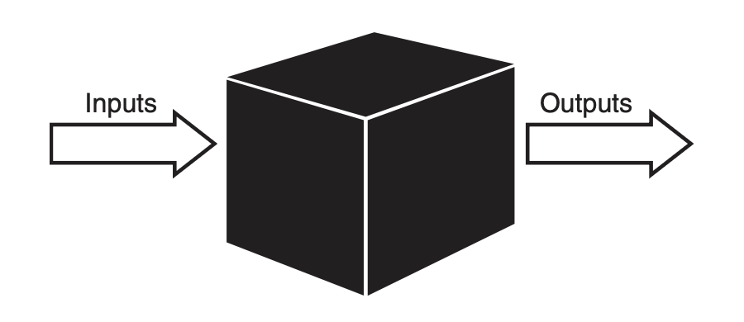
Procedural Versus OO Programming

Slide 4
Object forms with attributes and behaviors
An object is an entity that contains both data and behavior.
Behaviors are contained in methods
Attributes are contained in variables
A person has attributes, such as eye color, age, height, and so on.
A person also has behaviors, such as walking, talking, breathing, and so on.
In OO design, the attributes and behaviors are contained within a single object, whereas in procedural, or structured design, the attributes and behaviors are normally separated.

Slide 5
Let’s discuss some examples of Objects

Slide 6
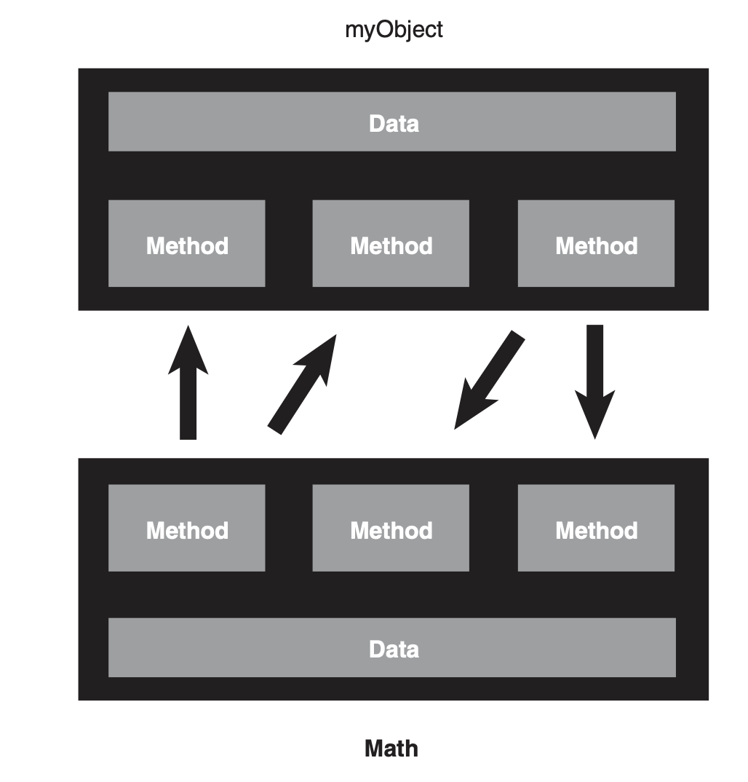
Class Design Guidelines
Data Hiding
Communication

Slide 7

How to communicate with Objects?

Slide 8
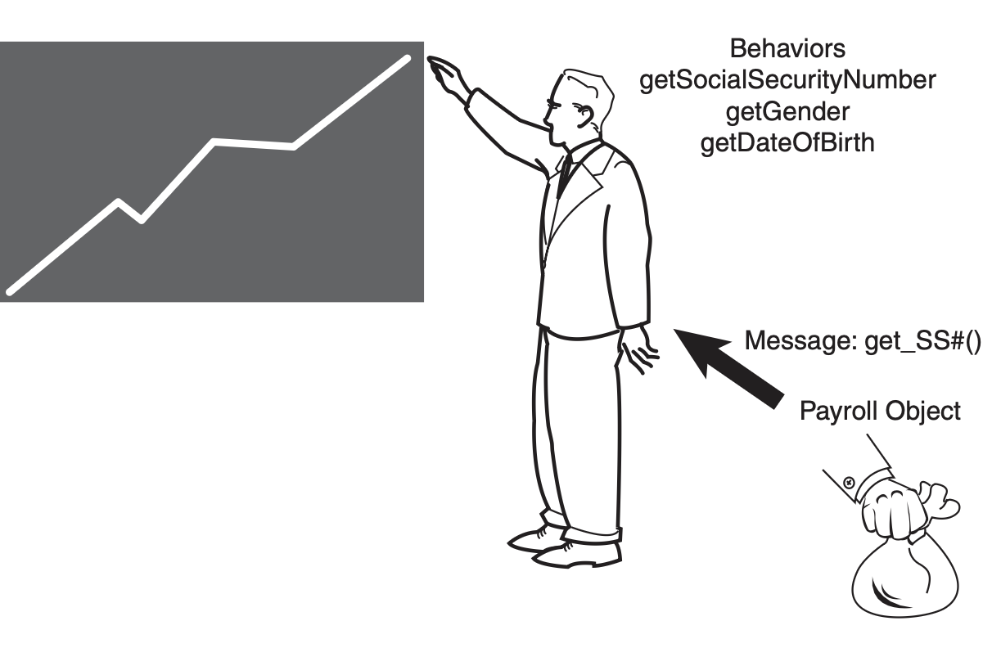
How to communicate with Objects?

Slide 9
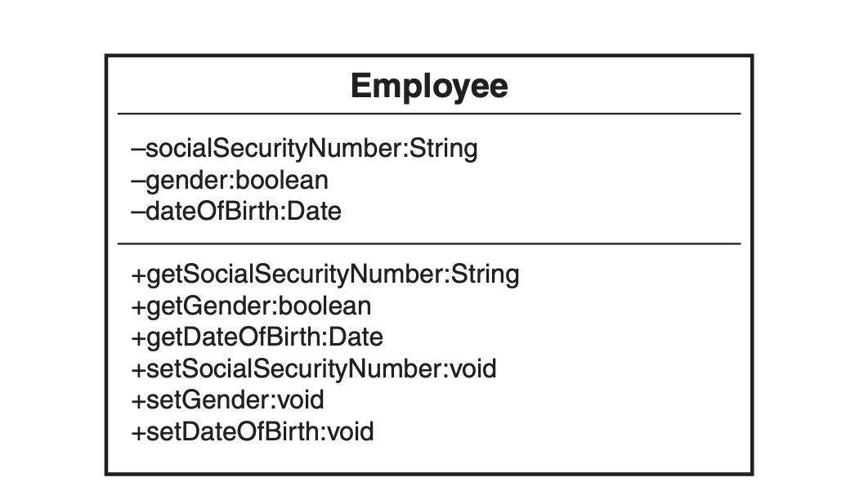
UML Class Diagrams

Slide 10
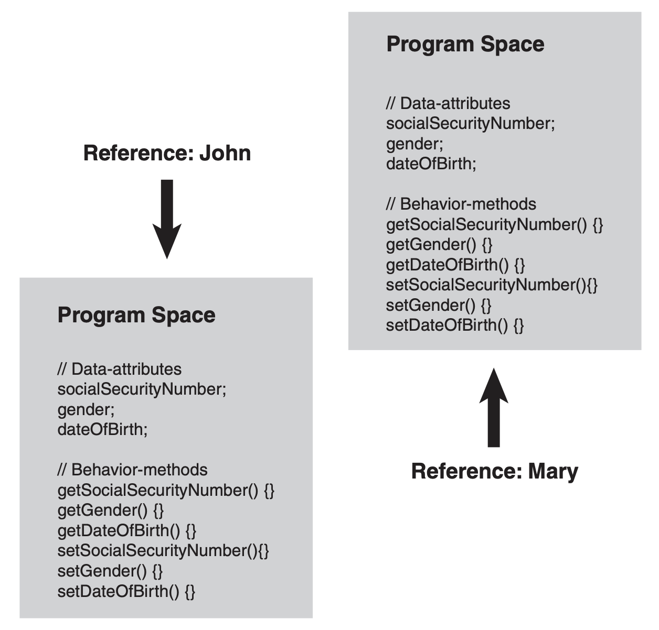
Program Space in OOP

Slide 11
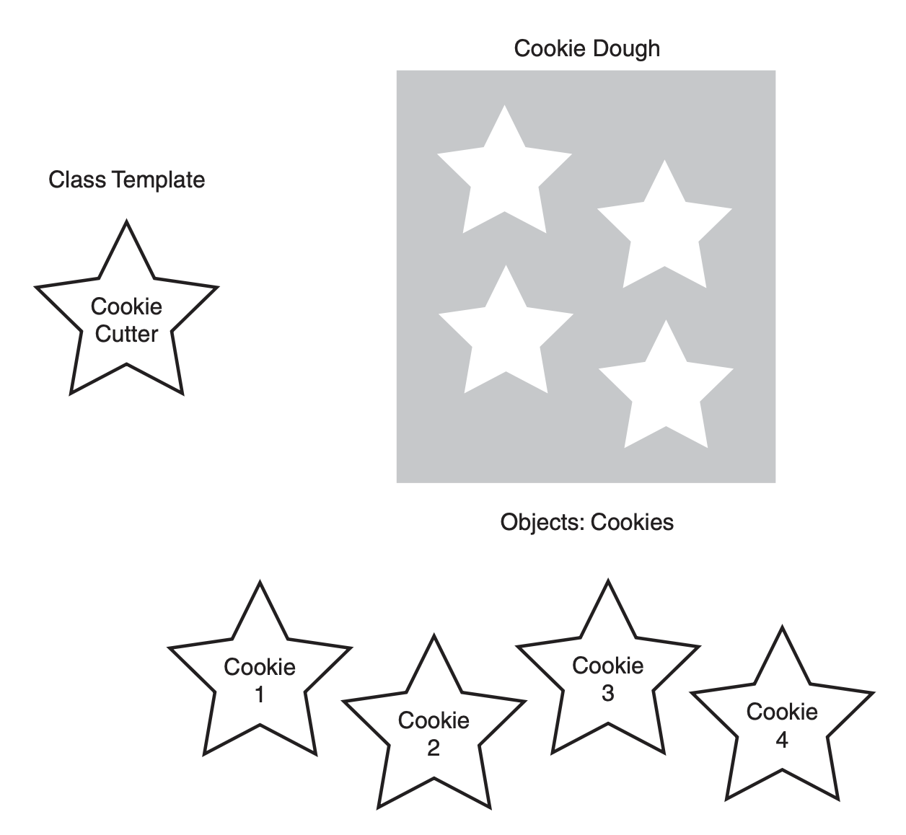
Classes Are Object Templates

Slide 12
Let’s design an UML class for Person
And design an UML class for Student

Slide 13
What is the relationship between a Person class and a Student class?

Slide 14
Inheritance
For reusing code – Inheritance allows subclasses to inherit functionality from a superclass, reducing code clone
For extending functionality – With inheritance, subclasses can add or override methods, extending the behavior of the parent class without modifying its code.
For establishing relationships – Inheritance creates a natural hierarchy between classes

Slide 15
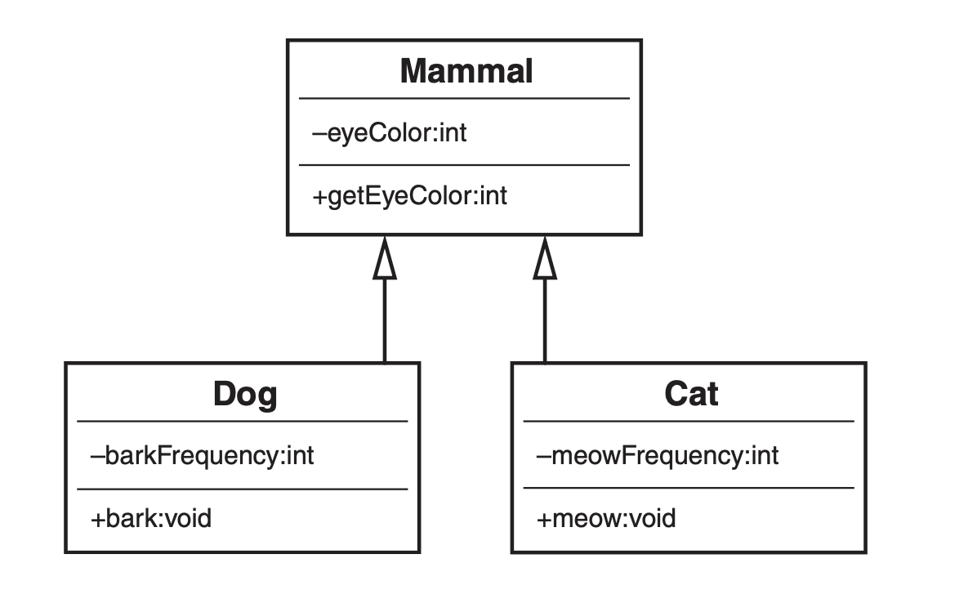
Mammal hierarchy

Slide 16
Superclasses and Subclasses
For code reuse : A subclass inherits attributes and methods from its superclass,
For specialization: A subclass can extend or modify the behavior of the superclass
For clear structure: The superclass defines general properties and methods, while the subclass refines or builds upon them

Slide 17
Abstraction
Abstraction allows developers to hide complex implementation details
Abstraction allows only expose the essential features
Abstraction helps separate the interface
By focusing on "what" an object does rather than "how" it does it

Slide 18
Example of Abstraction
package interface_example;
interface AnimalSound {
// Abstract method (no implementation)
void makeSound();
}
class Cat implements AnimalSound {
// Implementing the abstract method from the interface
public void makeSound() {
System.out.println("Meow! Meow!");
}
}

Slide 19
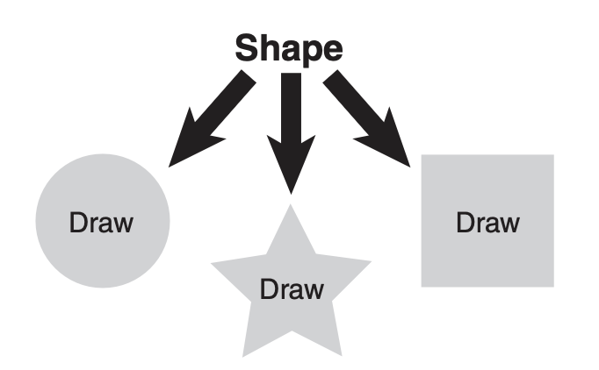
Is-a Relationships
How can an object be an 'is-a' object of other objects?

Slide 20
Super classes and Subclasses

Slide 21
Are superclass’s Constructor Inherited?
No. They are not inherited.
They are invoked explicitly (using the super keyword) or implicitly.
A constructor is used to construct an instance of a class.
Unlike properties and methods, a superclass's constructors are not inherited in the subclass.
They can only be invoked from the subclasses' constructors, using the keyword super.
If the keyword super is not explicitly used, the superclass's no-arg constructor is automatically invoked.

Slide 22
Superclass’s Constructor Is Always Invoked
A constructor may invoke an overloaded constructor or its superclass’s constructor. If none of them is invoked explicitly, the compiler puts super() as the first statement in the constructor. For example,

Slide 23
Using the Keyword super
The keyword super refers to the superclass of the class in which super appears. This keyword can be used in two ways:
To call a superclass constructor
To call a superclass method

Slide 24
CAUTION
You must use the keyword super to call the superclass constructor. Invoking a superclass constructor’s name in a subclass causes a syntax error.
Java requires that the statement that uses the keyword super appear first in the constructor.

Slide 25
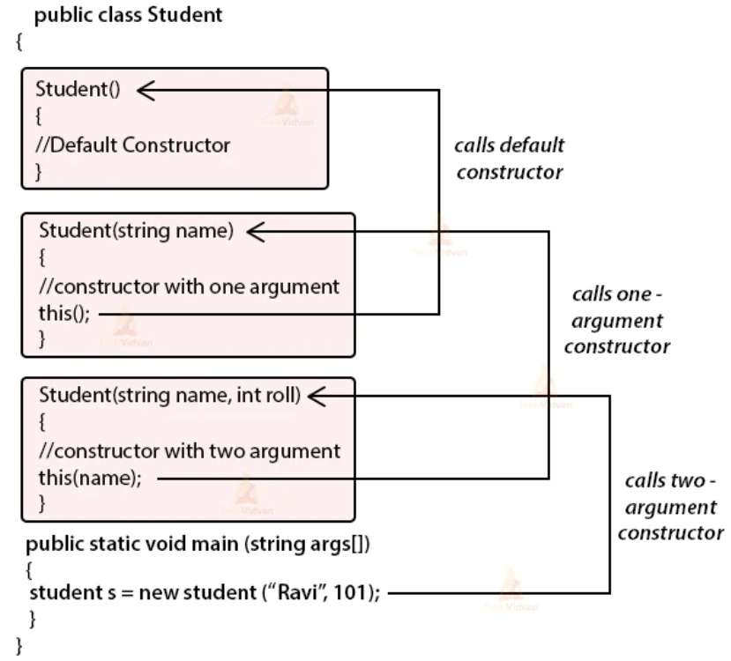
Constructor Chain
Constructing an instance of a class invokes all the superclasses’ constructors along the inheritance chain. This is called constructor chaining.
* Source: www.techvidvan.com

Slide 26
Constructor Chaining
public class Faculty extends Employee {
public static void main(String[] args) {
new Faculty();
}
public Faculty() {
System.out.println("Faculty's constructor is invoked");
} }
class Employee extends Person {
public Employee() {
System.out.println("Employee's constructor is invoked");
}
public Employee(String s) {
System.out.println(s);
} }
class Person {
public Person() {
System.out.println("Person's constructor is invoked");
} }

Slide 27
animation
public class Faculty extends Employee {
public static void main(String[] args) {
new Faculty();
}
public Faculty() {
System.out.println("Faculty's constructor is invoked");
}
}
class Employee extends Person {
public Employee() {
System.out.println("Employee's constructor is invoked");
}
public Employee(String s) {
System.out.println(s);
}
}
class Person {
public Person() {
System.out.println("Person's constructor is invoked");
}
}
1. Start from the main method

Slide 28
public class Faculty extends Employee {
public static void main(String[] args) {
new Faculty();
}
public Faculty() {
System.out.println("Faculty's no-arg constructor is invoked");
}
}
class Employee extends Person {
public Employee() {
System.out.println("Employee's no-arg constructor is invoked");
}
public Employee(String s) {
System.out.println(s);
}
}
class Person {
public Person() {
System.out.println("Person's no-arg constructor is invoked");
}
}
2. Invoke Faculty constructor

Slide 29
public class Faculty extends Employee {
public static void main(String[] args) {
new Faculty();
}
public Faculty() {
System.out.println("Faculty's no-arg constructor is invoked");
}
}
class Employee extends Person {
public Employee() {
System.out.println("Employee's no-arg constructor is invoked");
}
public Employee(String s) {
System.out.println(s);
}
}
class Person {
public Person() {
System.out.println("Person's no-arg constructor is invoked");
}
}
3. Invoke Employee’s no-arg constructor

Slide 30
public class Faculty extends Employee {
public static void main(String[] args) {
new Faculty();
}
public Faculty() {
System.out.println("Faculty's no-arg constructor is invoked");
}
}
class Employee extends Person {
public Employee() {
System.out.println("Employee's no-arg constructor is invoked");
}
public Employee(String s) {
System.out.println(s);
}
}
class Person {
public Person() {
System.out.println("Person's no-arg constructor is invoked");
}
}
4. Invoke Employee’s arg constructor

Slide 31
public class Faculty extends Employee {
public static void main(String[] args) {
new Faculty();
}
public Faculty() {
System.out.println("Faculty's no-arg constructor is invoked");
}
}
class Employee extends Person {
public Employee() {
System.out.println("Employee's no-arg constructor is invoked");
}
public Employee(String s) {
System.out.println(s);
}
}
class Person {
public Person() {
System.out.println("Person's no-arg constructor is invoked");
}
}
5. Invoke Person() constructor

Slide 32
public class Faculty extends Employee {
public static void main(String[] args) {
new Faculty();
}
public Faculty() {
System.out.println("Faculty's no-arg constructor is invoked");
}
}
class Employee extends Person {
public Employee() {
System.out.println("Employee's no-arg constructor is invoked");
}
public Employee(String s) {
System.out.println(s);
}
}
class Person {
public Person() {
System.out.println("Person's no-arg constructor is invoked");
}
}
6. Execute println

Slide 33
Output Sequence?
public class Faculty extends Employee {
public static void main(String[] args) {
new Faculty();
}
public Faculty() {
System.out.println("Faculty's no-arg constructor is invoked");
}
}
class Employee extends Person {
public Employee() {
System.out.println("Employee's no-arg constructor is invoked");
}
public Employee(String s) {
System.out.println(s);
}
}
class Person {
public Person() {
System.out.println("Person's no-arg constructor is invoked");
}
}

Slide 34
Output Sequence?
public class Faculty extends Employee {
public static void main(String[] args) {
new Faculty();
}
public Faculty() {
System.out.println("Faculty's no-arg constructor is invoked");
}
}
class Employee extends Person {
public Employee() {
System.out.println("Employee's no-arg constructor is invoked");
}
public Employee(String s) {
System.out.println(s);
}
}
class Person {
public Person() {
System.out.println("Person's no-arg constructor is invoked");
}
}
Person's no-arg constructor is invoked
Employee's no-arg constructor is invoked
Faculty's no-arg constructor is invoked

Slide 35
Example on the Impact of a Superclass without no-arg Constructor
Find out the errors in the program:
public class Apple extends Fruit {
}
class Fruit {
public Fruit(String name) {
System.out.println("Fruit's constructor is invoked");
}
}

Slide 36
Example on the Impact of a Superclass without no-arg Constructor
If there is no constructor, default no-arg one is added.
If there is a constructor of any kind, the default no-arg constructor is not added.
public class Apple extends Fruit {
}
class Fruit {
public Fruit(String name) {
System.out.println("Fruit's constructor is invoked");
}
}

Slide 37
Overriding vs. Overloading

Slide 38
NOTE
An instance method can be overridden only if it is accessible. Thus a private method cannot be overridden, because it is not accessible outside its own class. If a method defined in a subclass is private in its superclass, the two methods are completely unrelated.

Slide 39
The toString() method in Object
The toString() method returns a string representation of the object. The default implementation returns a string consisting of a class name of which the object is an instance, the at sign (@), and a number representing this object.
Loan loan = new Loan();
System.out.println(loan.toString());
The code displays something like Loan@15037e5 . This message is not very helpful or informative. Usually you should override the toString method so that it returns a digestible string representation of the object.

Slide 40
Polymorphism
Polymorphism means many (poly) shapes (morph)
In Java, polymorphism refers to the fact that you can have multiple methods with the same name in the same class
There are two kinds of polymorphism:
Overloading
Two or more methods with different signatures
Overriding
Replacing an inherited method with another having the same signature

Slide 41
Polymorphism
Polymorphism allows a subclass to provide its specific implementation of a method that is already defined in its superclass
With polymorphism, a single method or function can operate on different types of objects
By using polymorphism, we can write cleaner and more concise code, as we don’t need to manually check the object type before performing operations

Slide 42
Overloading
class Test { public static void main(String args[]) { myPrint(5); myPrint(5.0); }
static void myPrint(int i) { System.out.println("int i = " + i); }
static void myPrint(double d) { // same name, different parameters System.out.println("double d = " + d); } }
int i = 5 double d = 5.0

Slide 43
Why overload a method?

Slide 44
DRY (Don’t Repeat Yourself)
When you overload a method with another, very similar method, only one of them should do most of the work:
void debug() { System.out.println("first=" + first + ", last="+ last);
... ...
System.out.println(); }
void debug(String s) { System.out.println("At checkpoint " + s + ":"); debug(); }

Slide 45
Another reason to overload methods
You may want to do “the same thing” with different kinds of data:
class Student extends Person { ... void printInformation() { printPersonalInformation(); printGrades(); } }
class Professor extends Person() { ... void printInformation() { printPersonalInformation(); printResearchInterests(); } }
Java’s print and println methods are heavily overloaded

Slide 46
Legal assignments
class Test { public static void main(String args[]) { double d; int i; d = 5; // legal i = 3.5; // illegal i = (int) 3.5; // legal } }
Widening is legal
Narrowing is illegal (unless you cast)

Slide 47
Legal method calls
class Test { public static void main(String args[]) { myPrint(5); }
static void myPrint(double d) { System.out.println(d); } }
5.0
Legal because parameter transmission is equivalent to assignment
myPrint(5) is like double d = 5; System.out.println(d);

Slide 48
Illegal method calls
class Test { public static void main(String args[]) { myPrint(5.0); }
static void myPrint(int i) { System.out.println(i); } }
myPrint(int) in Test cannot be applied to (double)
Illegal because parameter transmission is equivalent to assignment
myPrint(5.0) is like int i = 5.0; System.out.println(i);

Slide 49
Superclass construction
Unless you specify otherwise, every constructor calls the default constructor for its superclass
class Foo extends Bar { Foo() { // constructor super(); // invisible call to superclass constructor ...
You can use this(...) to call another constructor in the same class:
class Foo extends Bar { Foo(String message) { // constructor this(message, 0, 0); // explicit call to another constructor ...
You can use super(...) to call a specific superclass constructor
class Foo extends Bar { Foo(String name) { // constructor super(name, 5); // explicit call to superclass constructor ...
Since the call to another constructor must be the very first thing you do in the constructor, you can only do one of the above

Slide 50
Summary
We can think the relation between multiple classes
Can make an inheritance
Can design a bit complex scenario with superclass and subclass
Can write multiple methods with same name
Can distinguish method overloading and overriding
Can think about the construction chain
Can design basic OOP problems

Slide 51
See you next day …

